Slide 1



Twitter Sentiment Data Analysis
PROJECT GUIDE
Ms.S.HAMSANANDHINI
Assistant Professor AI
PROJECT MEMBER
VAANMUGILAN T(22ALR107)
SHYAM S(22ALR091)
RAGUL G(22ALR074)

Slide 2
PROBLEM STATEMENT
Twitter data contains vast insights, but analyzing it can be challenging without proper tools. The goal is to develop a Power BI dashboard that visualizes key metrics such as tweet activity trends, sentiment analysis, popular hashtags, and key influencers. The dashboard should also provide insights into the geographical distribution of tweets, helping to identify regional engagement patterns. By leveraging this analysis, businesses, marketers, or researchers can better understand public sentiment, monitor trending topics, and make informed decisions. This solution will transform raw Twitter data into actionable insights for improving engagement and social media strategy.

Slide 3
DATASET
https://www.kaggle.com/datasets/crowdflower/twitter-airline-sentiment?resource=download

Slide 4
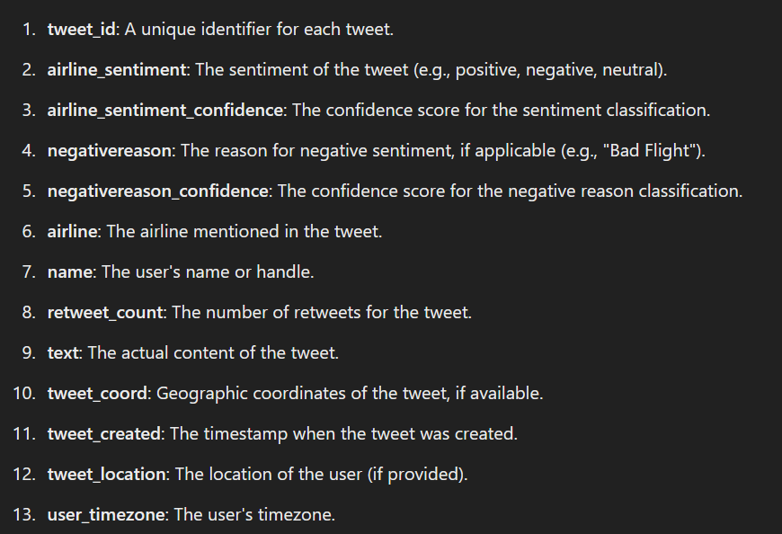
Dataset Description

Slide 5
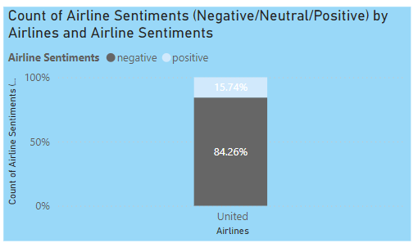
QUESTIONS
1.What percentage of tweets about United Airlines have a positive sentiment?

Slide 6
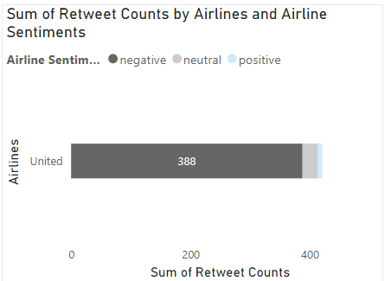
2.How many retweets are associated with positive sentiment for United Airlines?

Slide 7
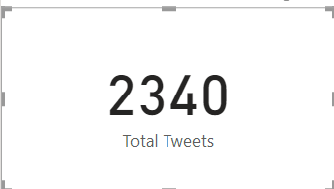
3.How many total tweets are analyzed in the dashboard?

Slide 8
4.How do the different airlines compare in terms of total tweet counts by sentiment?
America:313
Delta:544
Southwest:570
United:492
Us Airways:269
Virgin America:152

Slide 9
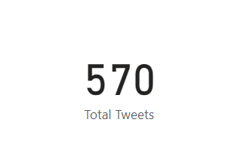
5.Which sentiment (negative, neutral, positive) has the highest number of tweets for Southwest airlines combined?
Positive is higher

Slide 10
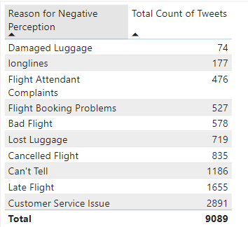
6.Which reason for negative perception has the least number of tweets?

Slide 11
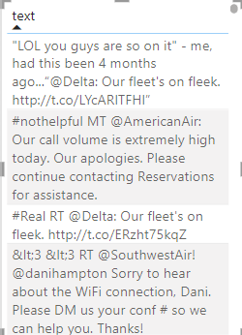
7.What is the most frequent sentiment for the "Late Flight" issue?

Slide 12
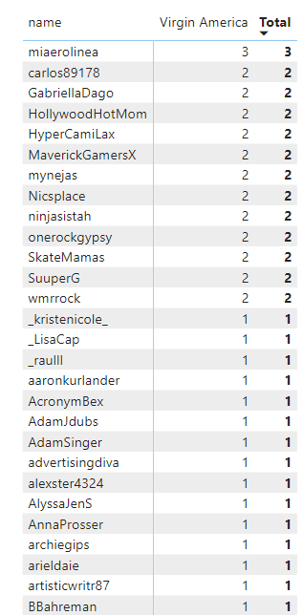
8.From the Second Image:Which user has the highest count of positive tweets about Virgin America?

Slide 13
9.How many users have posted exactly two positive tweets about Virgin America?
52

Slide 14
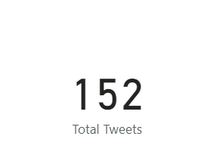
10.What is the total number of positive tweets related to Virgin America?

Slide 15
THANK YOU

